Slide 1

Food Waste Management
G H Patel College of Engineering & Technology Academic Year: 2021-22 (SEM 5)
Guided by :
Prof. Brijesh Patel
Prof. Sneh Vyas
Made by : Payal Khah
(190110107080)

Slide 2
INTRODUCTION
There is growing evidence that a significant share of global food is thrown away. Reducing food waste is a key sustainability challenge for the food service industry. .Everyday people are wasting food.
We are designing this website in order to reduce that food wastage problem. In this software the donor(the one who has extra food) can enter their Location, amount of food they want to distribute.Then a simple notification is generated in the website and the agent among that location can login & can gather the details of the food donor .The donor can hold an account in this application & whenever there is food wastage he can login and enter the details of food and location.

Slide 3
FUNCTIONAL REQUIREMENTS
NGOs
Authentication
Uploading organization info.
Booking acceptance/decline
Room for cancellation
Customer Feedback
Users
Location based service
User information
Usage history
User authentication
Addition and Modification of information
Assign user passwords
Be a Volunteers

Slide 4
Non-Functional Requirements
Interactive UI
Database Security and availability
Good search module
News Feed
Availability of Volunteers
Mobile friendly
Good response time
Live Tracking
Better recommendations

Slide 5
MARKET SURVEY
The global food waste management market grew at a CAGR of around 5% during 2015-2020. Food waste management involves various activities that are essential for disposing of food waste. It also includes the waste prevention, collection, treatment, recovery, transportation as well as recycling with the help of various management procedures. Some of these disposal techniques include landfills, composting, and anaerobic digestion of the generated wastes that are being employed across the commercial and residential segments. The increasing requirement for food waste management can be largely attributed to the rise in food processing waste, which includes agricultural, dairy food, poultry and seafood processing waste.

Slide 6
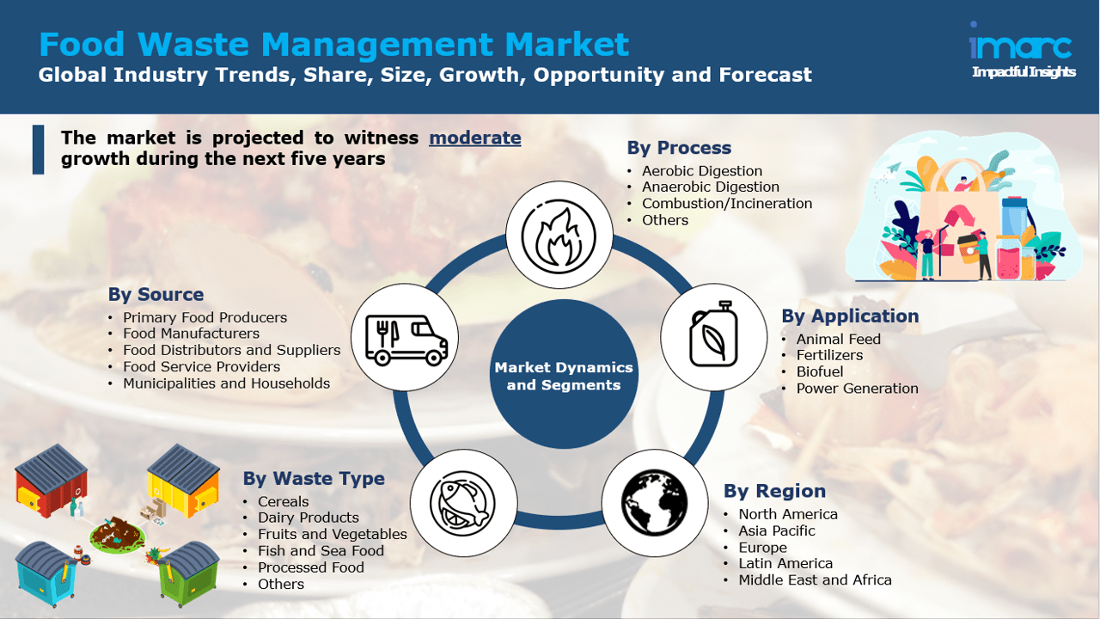

Slide 7
Food Waste Management Market Report Scope
Report Attribute | Details
Market size value in 2020 | USD 35.97 billion
Revenue forecast in 2027 | USD 52.03 billion
Growth Rate | CAGR of 5.4% from 2020 to 2027
Base year for estimation | 2019
Historical data | 2016 - 2018
Forecast period | 2020 - 2027
Quantitative units | Revenue in USD million and CAGR from 2020 to 2027
Report coverage | Revenue forecast, company ranking, competitive landscape, growth factors, and trends
Segments covered | Waste type, source, application, process, region
Regional scope | North America; Europe; Asia Pacific; Central & South America; Middle East & Africa
Country scope | U.S.; Canada; Mexico; France; Germany; Italy; U.K.; China; India; Japan; South Korea; Australia; Brazil; South Africa
Key companies profiled | Veolia; Suez; Waste Management, Inc.; Republic Services, Inc.; Covanta Ltd.; Stericycle, Inc.
Customization scope | Free report customization (equivalent up to 8 analysts working days) with purchase. Addition or alteration to country, regional & segment scope

Slide 8
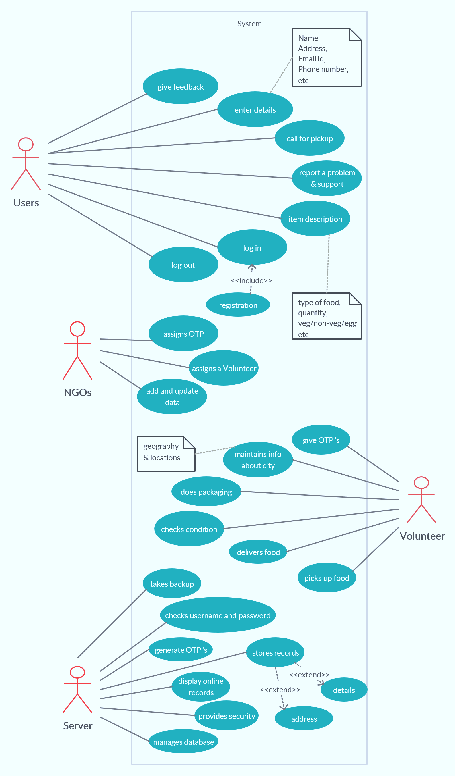
USE CASE

Slide 9
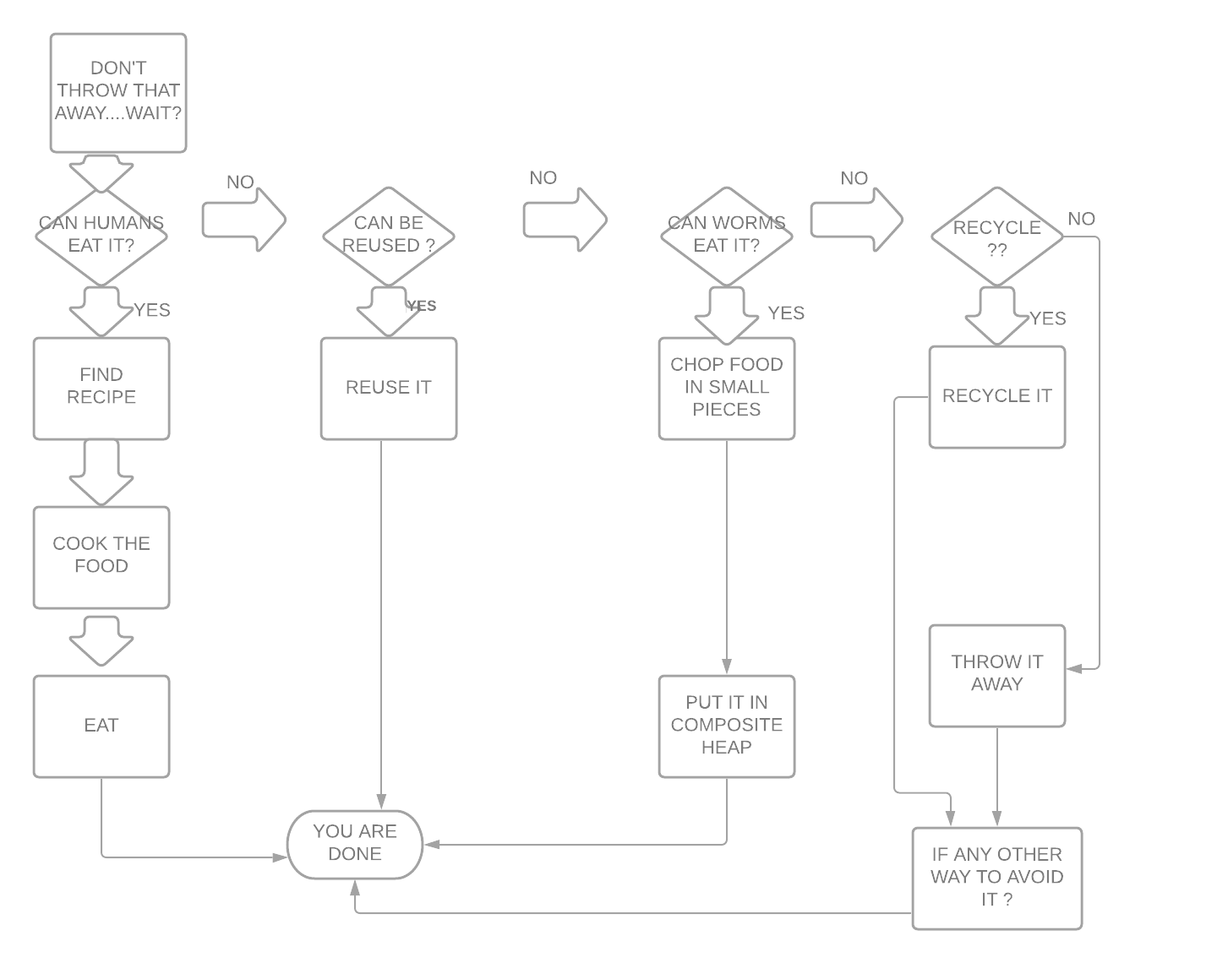
E-R DIAGRAM

Slide 10
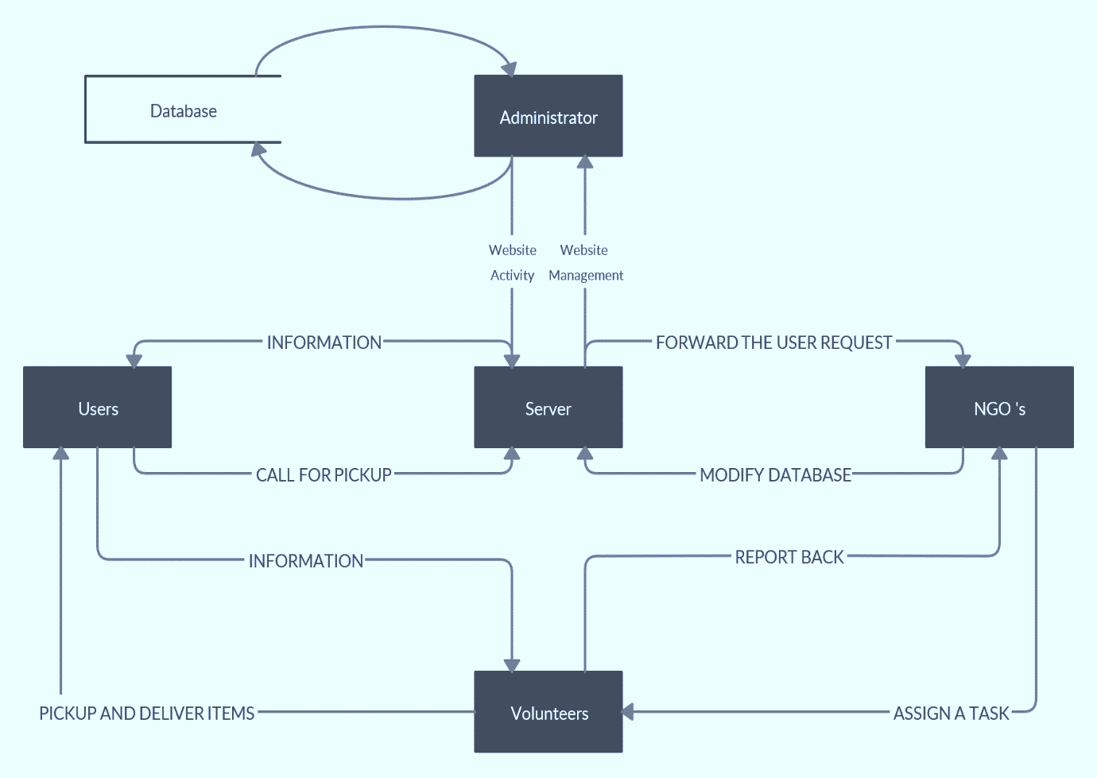
DFD : LEVEL 0

Slide 11
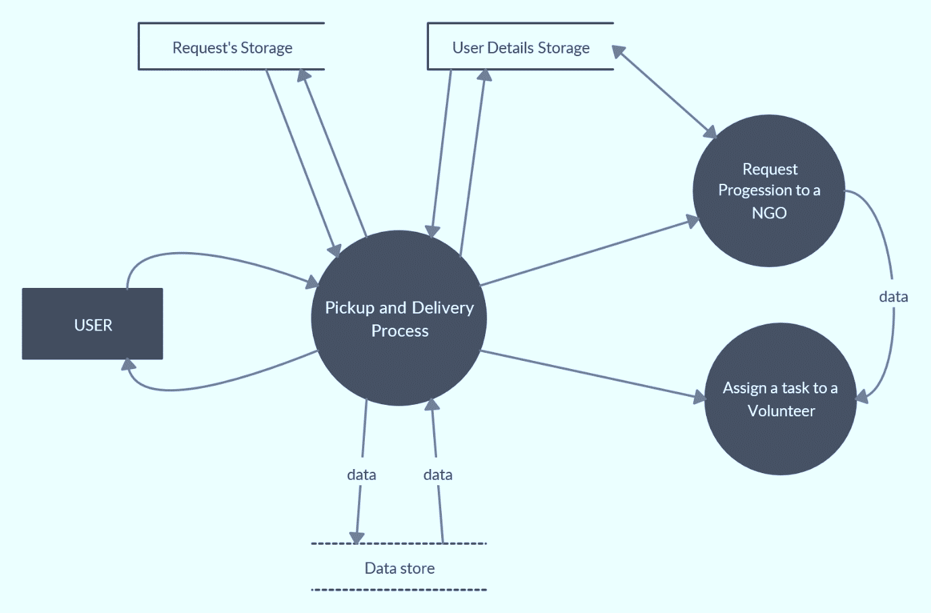
DFD : LEVEL 1

Slide 12
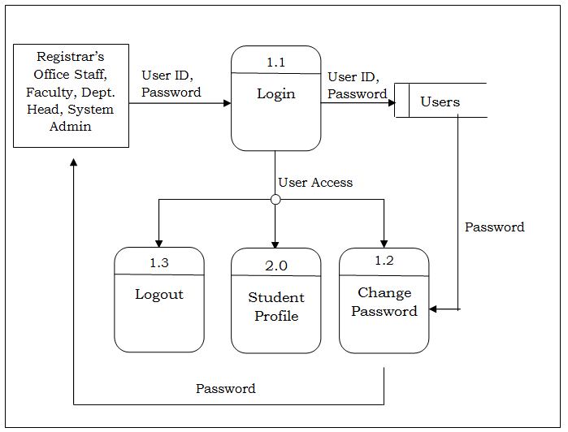
DFD : LEVEL 2

Slide 13
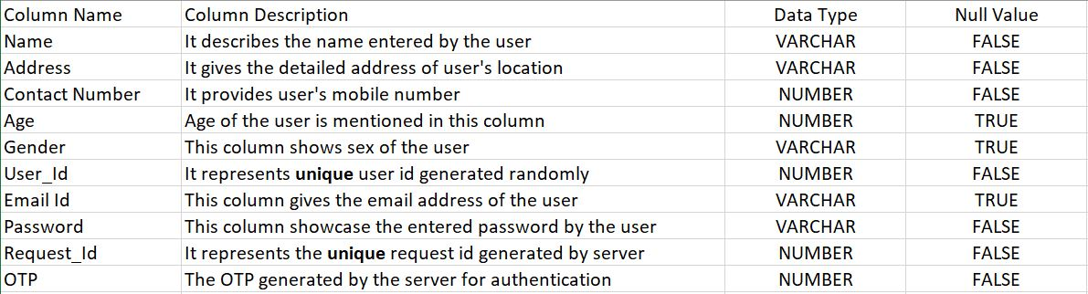
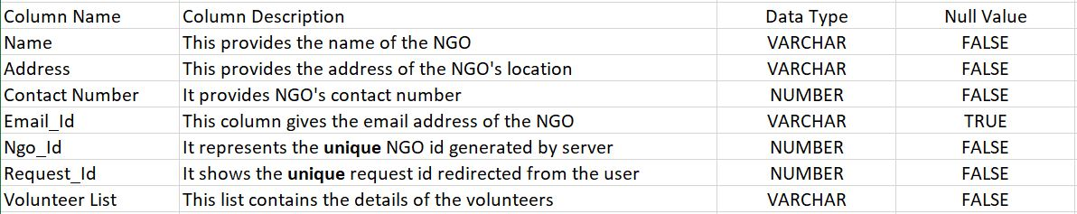
DATA DICTIONARY
TABLE : USER
TABLE : NGO

Slide 14
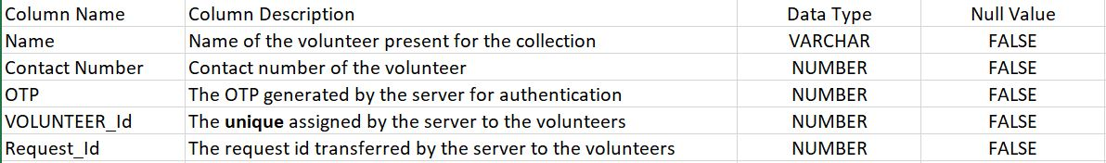
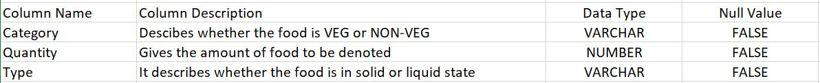
TABLE : VOLUNTEER
TABLE : FOOD

Slide 15
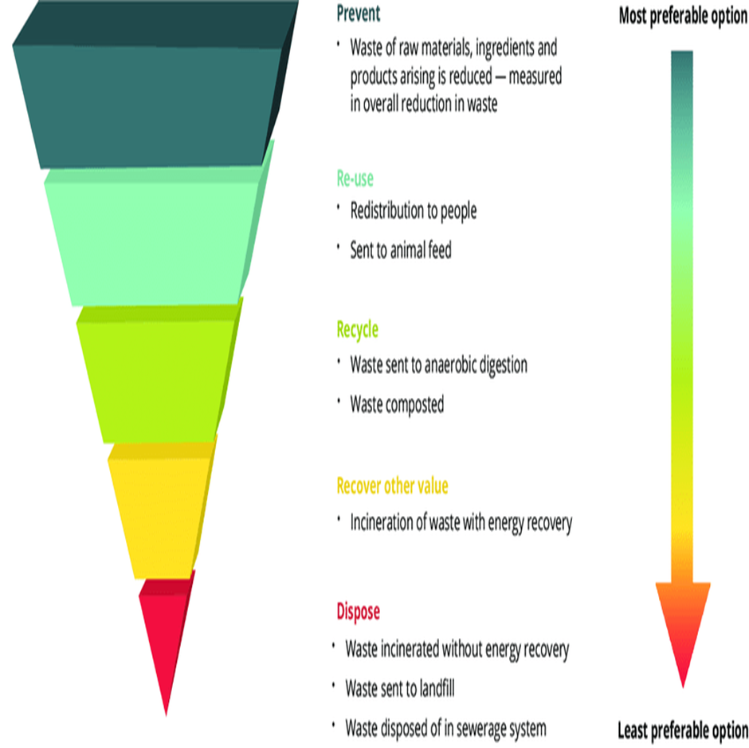
ACTIVITY DIAGRAM

Slide 16
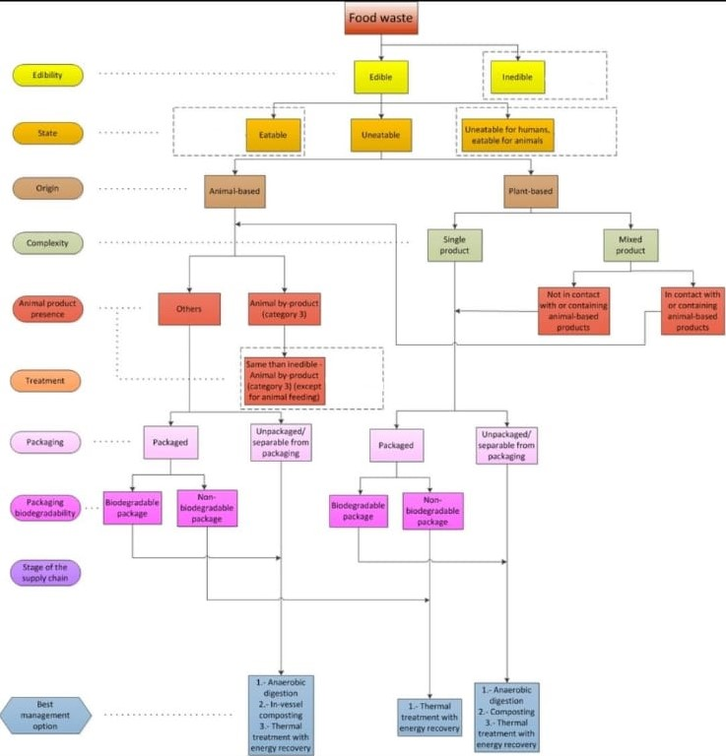

CLASS DIAGRAM

Slide 17
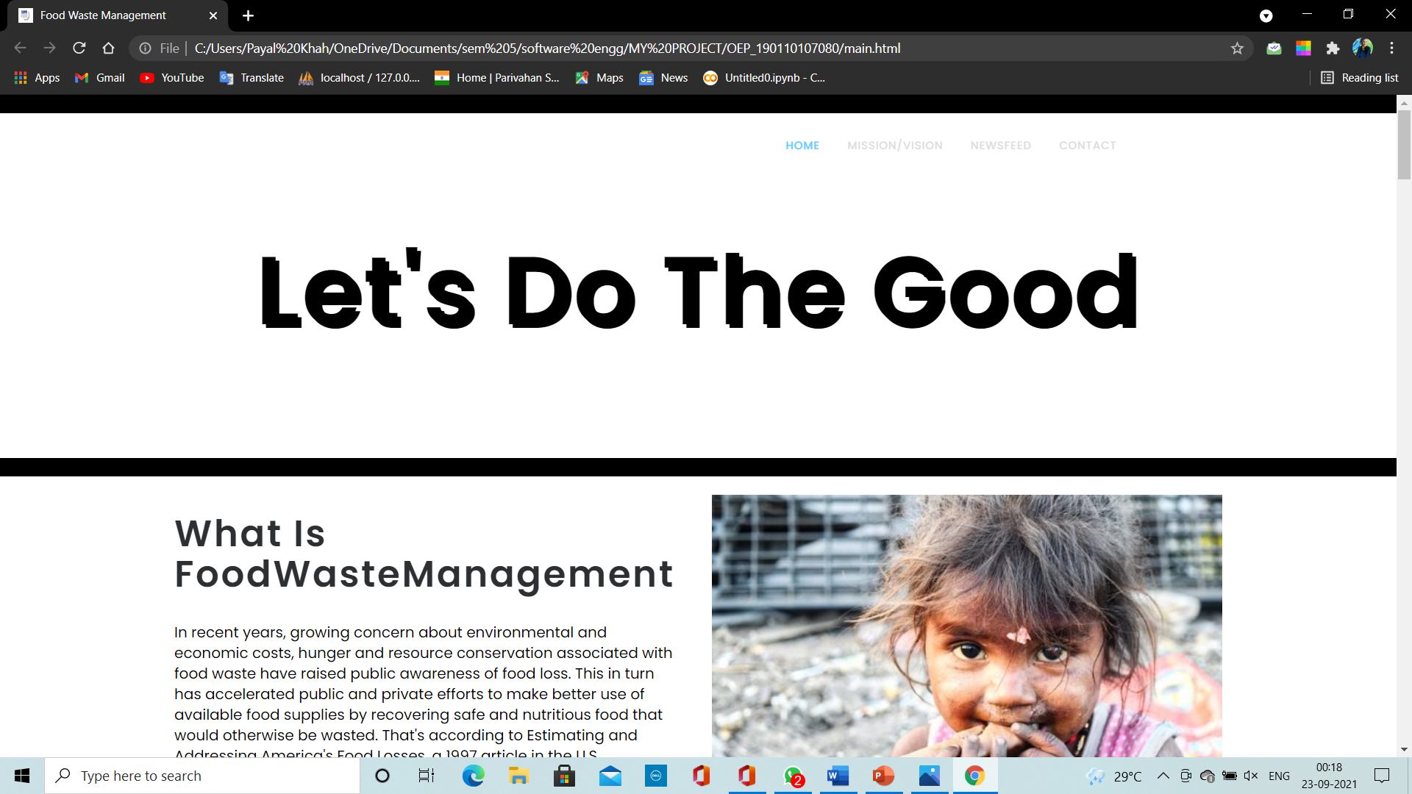
IMPLEMENTATION

Slide 18
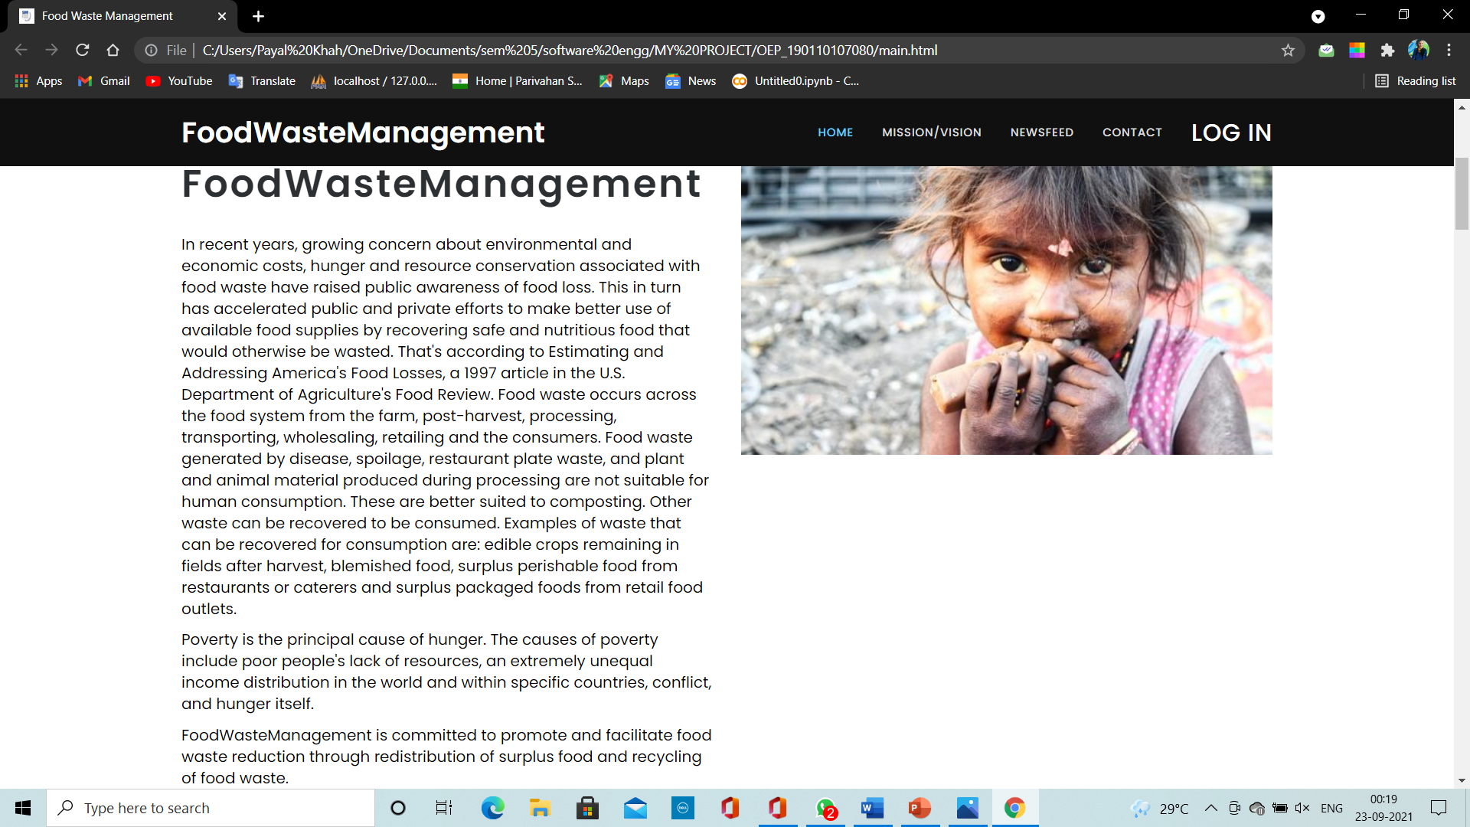
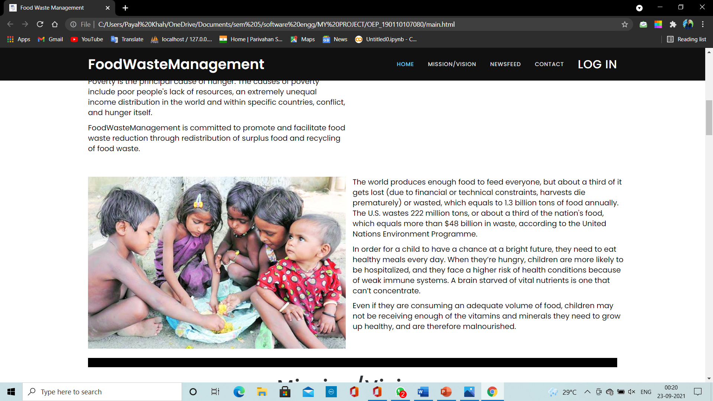

Slide 19
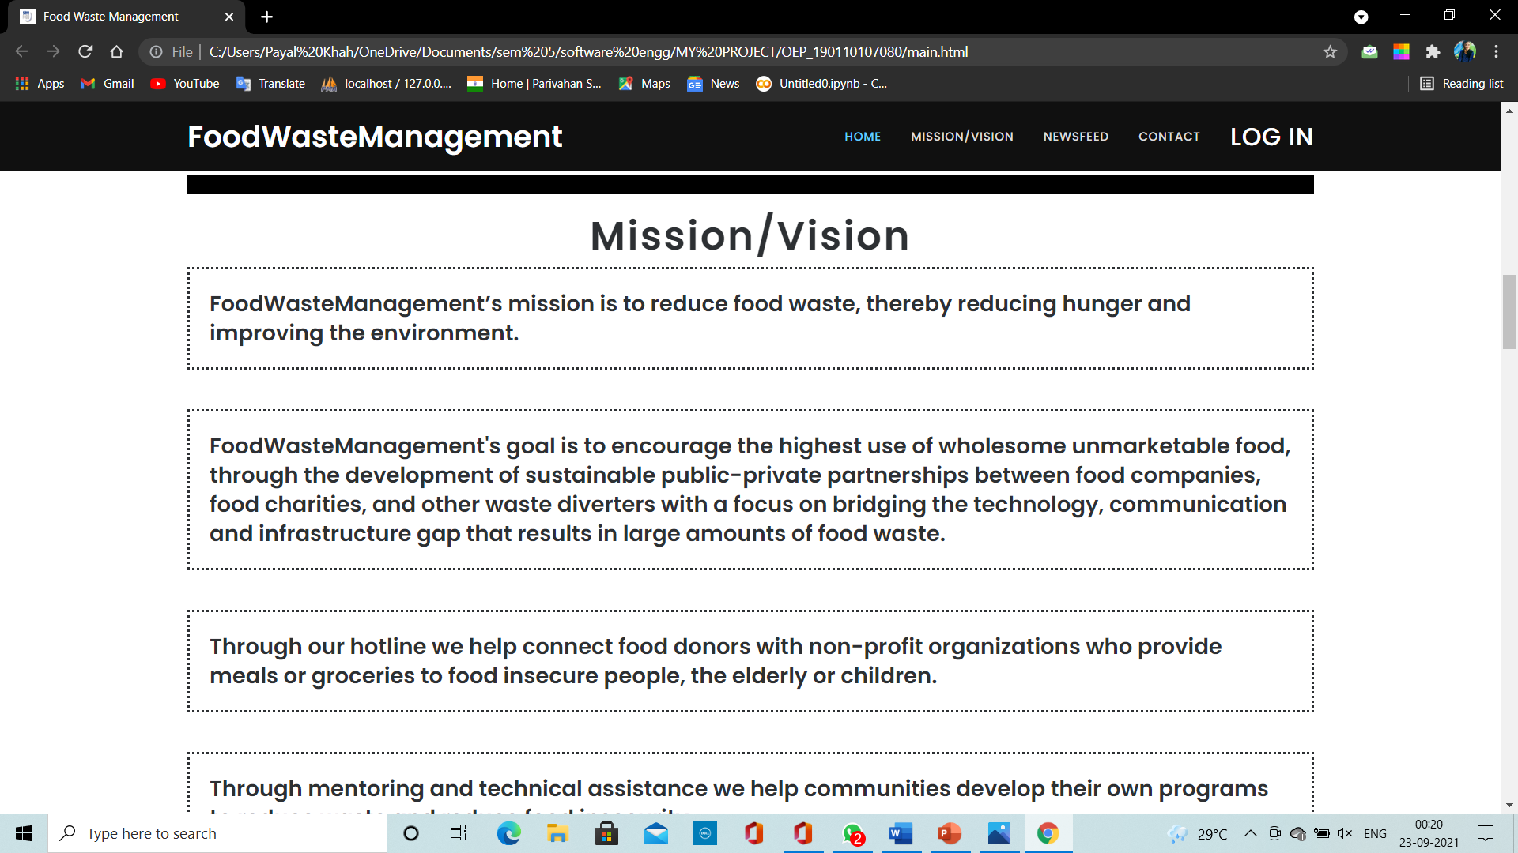
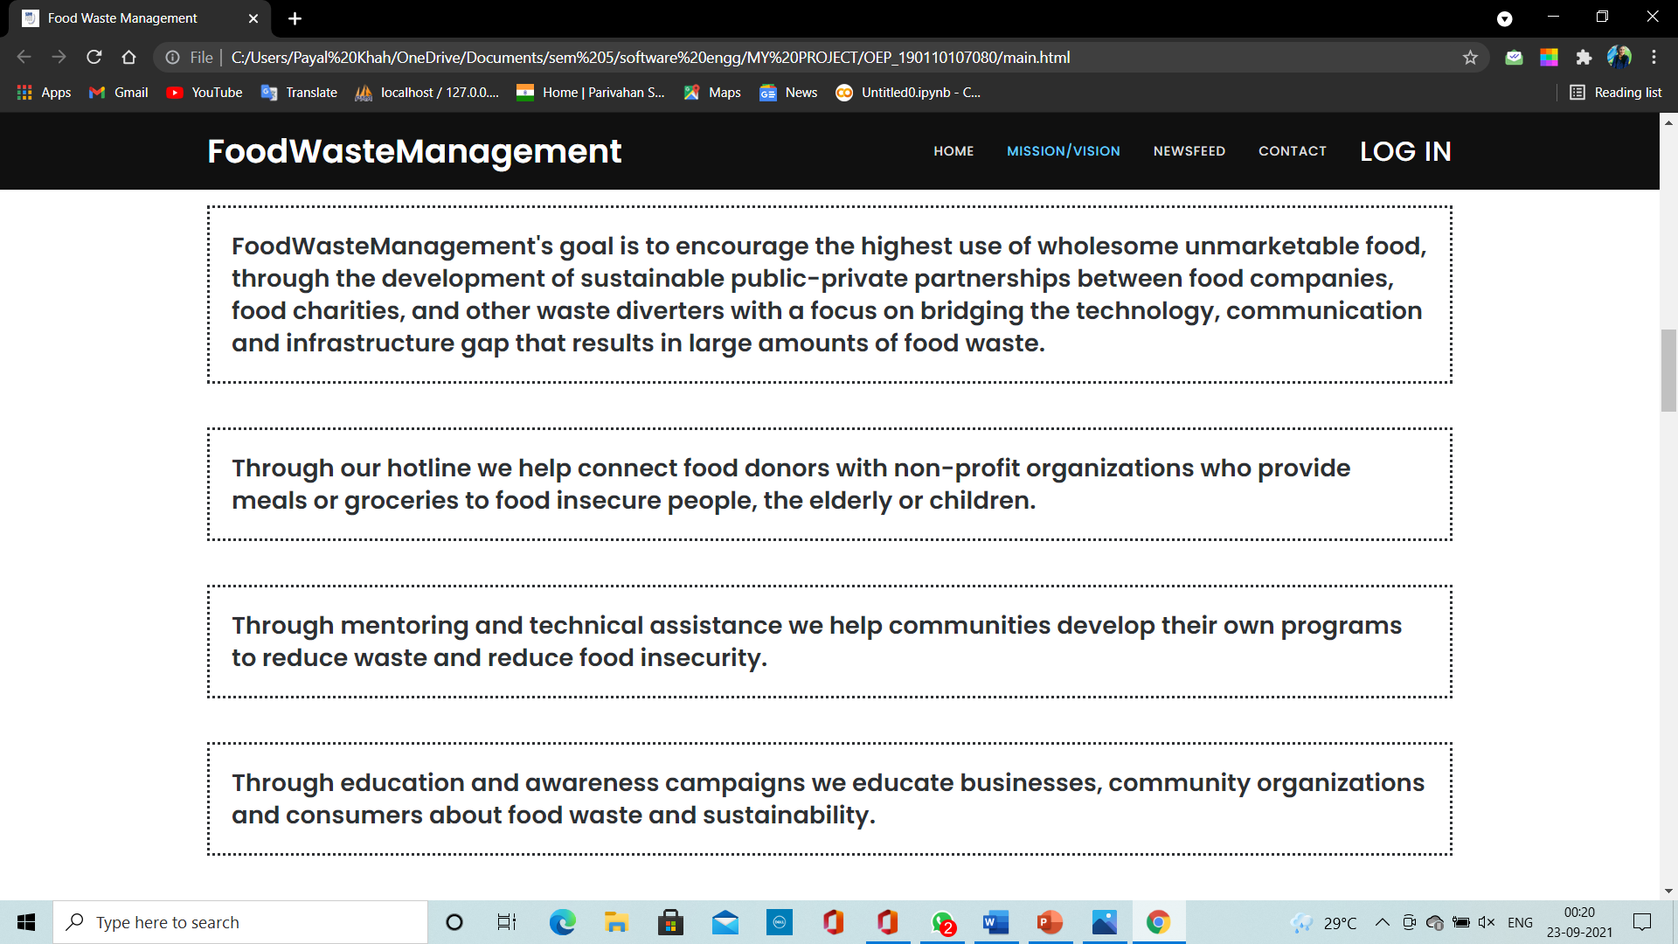

Slide 20
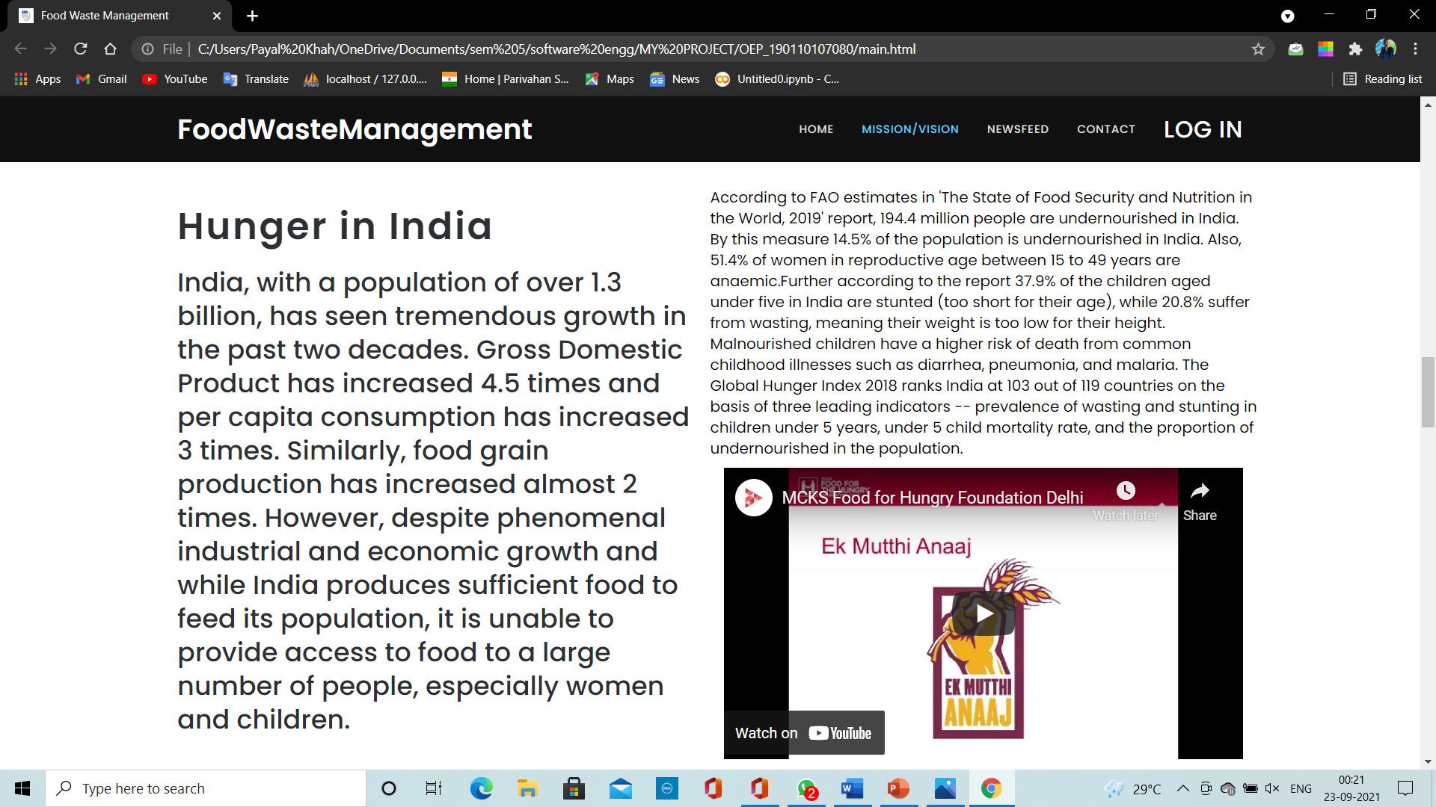
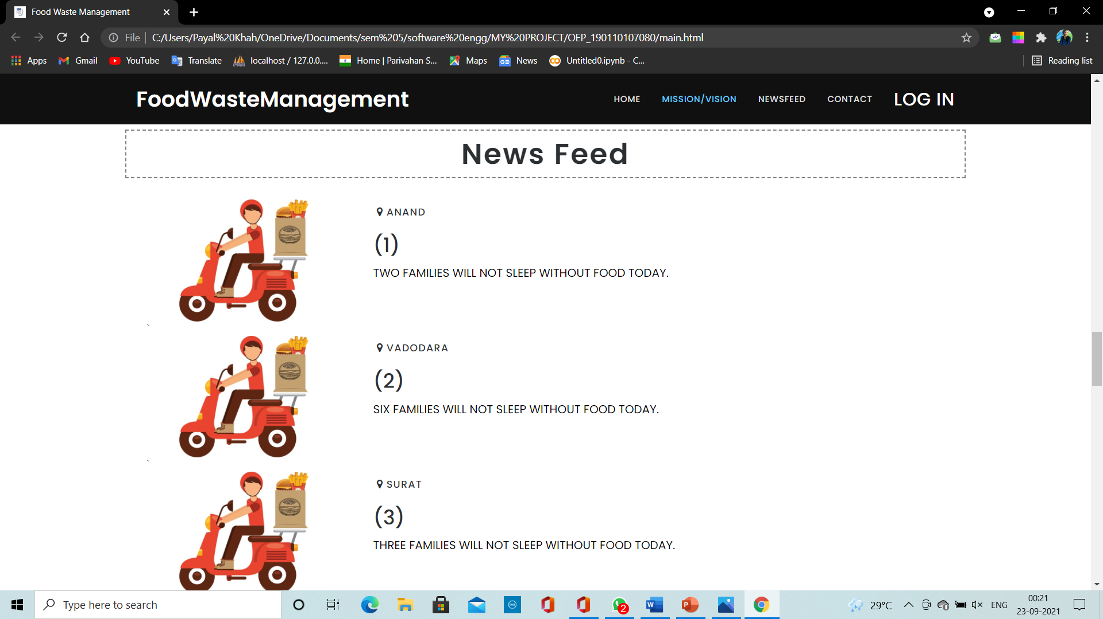

Slide 21
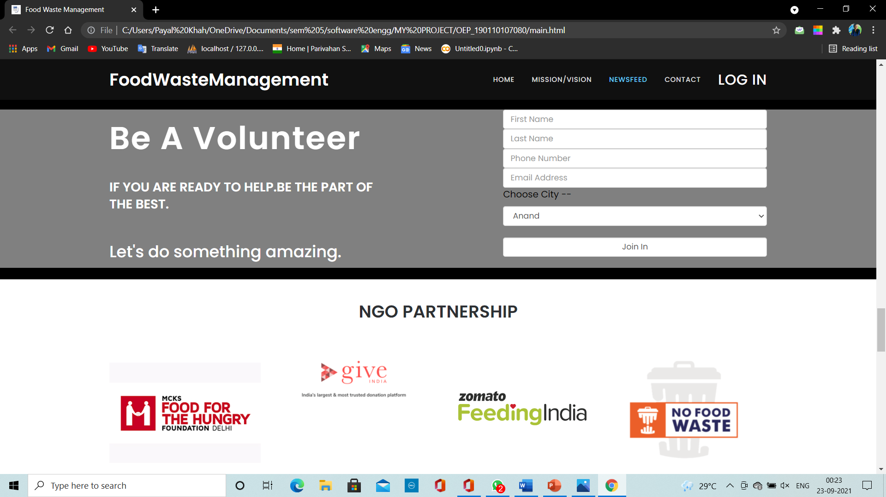

Slide 22
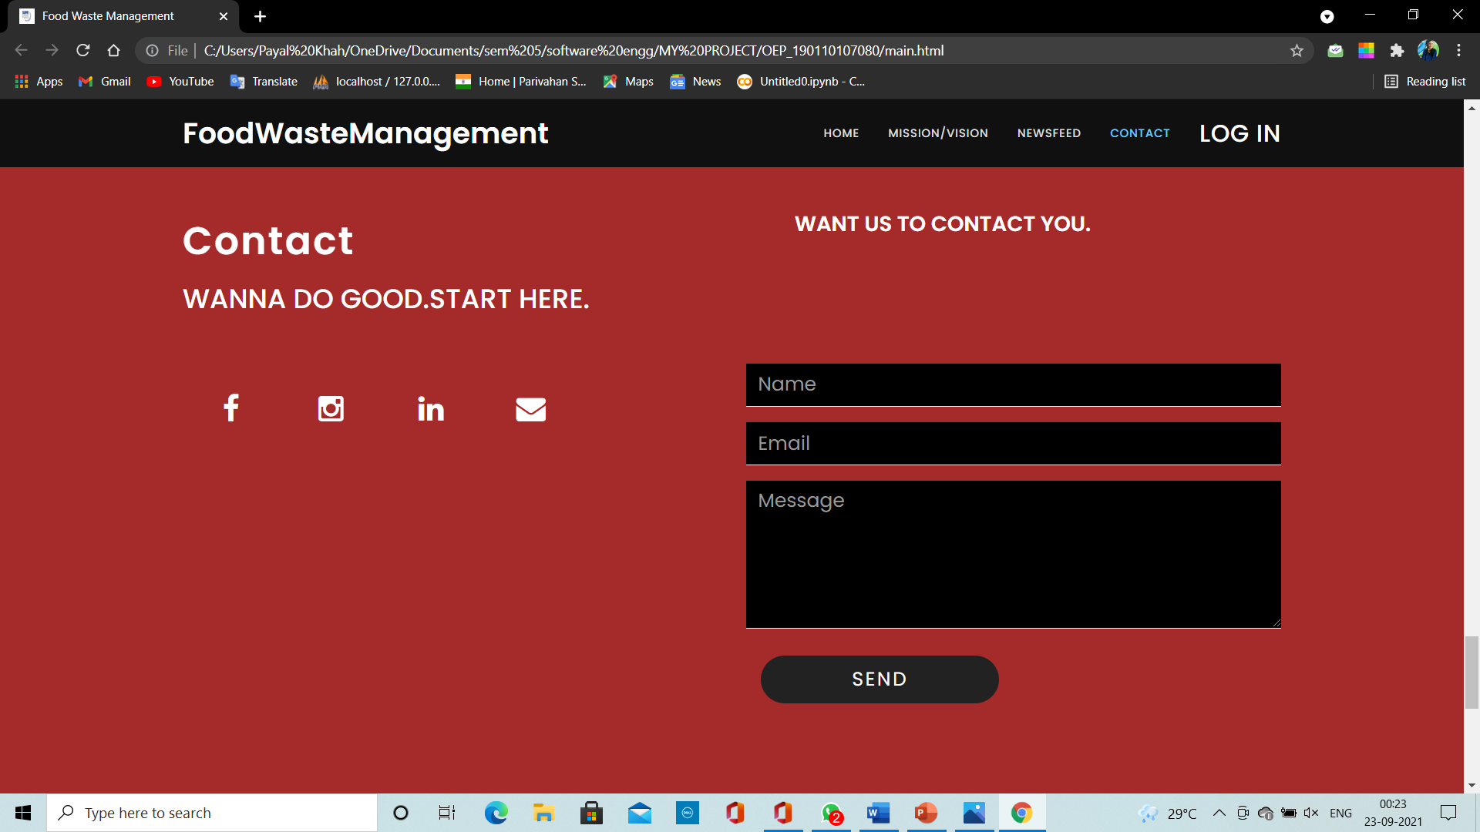
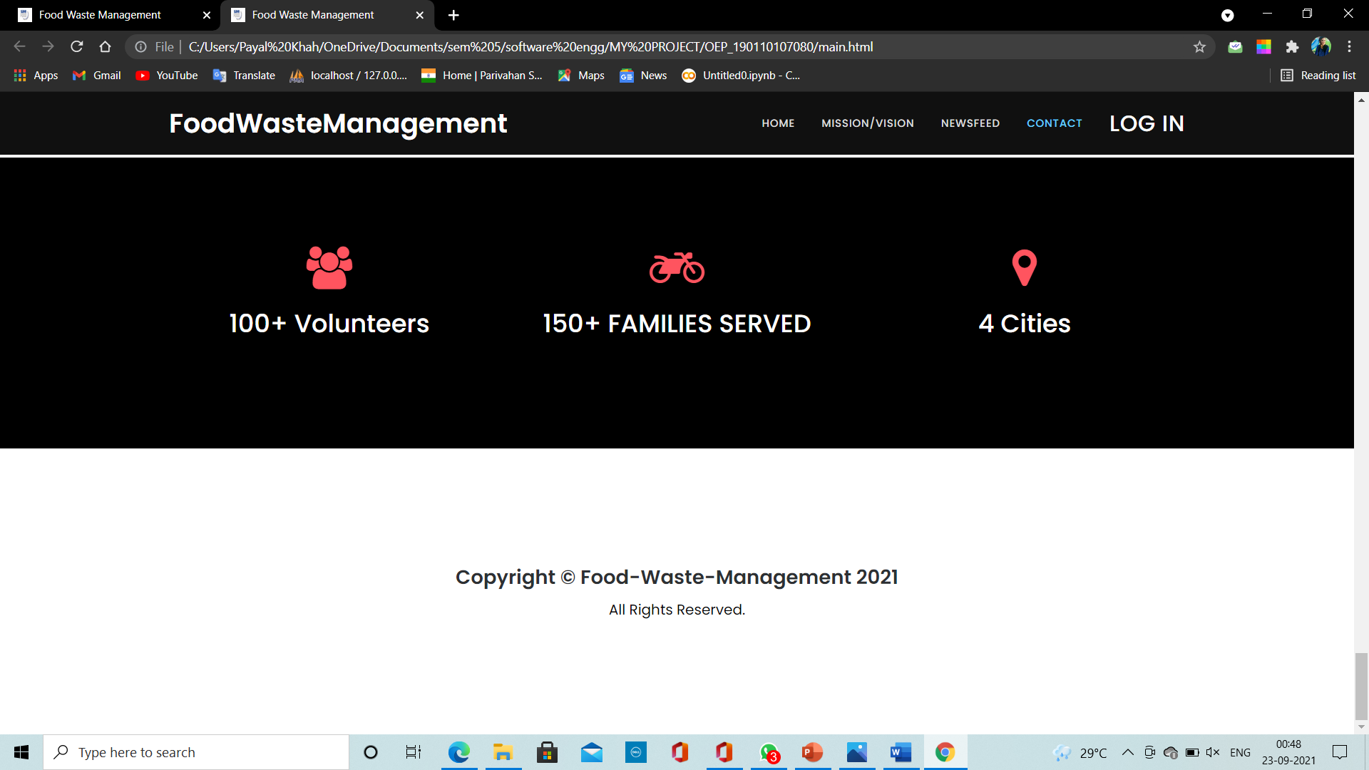

Slide 23
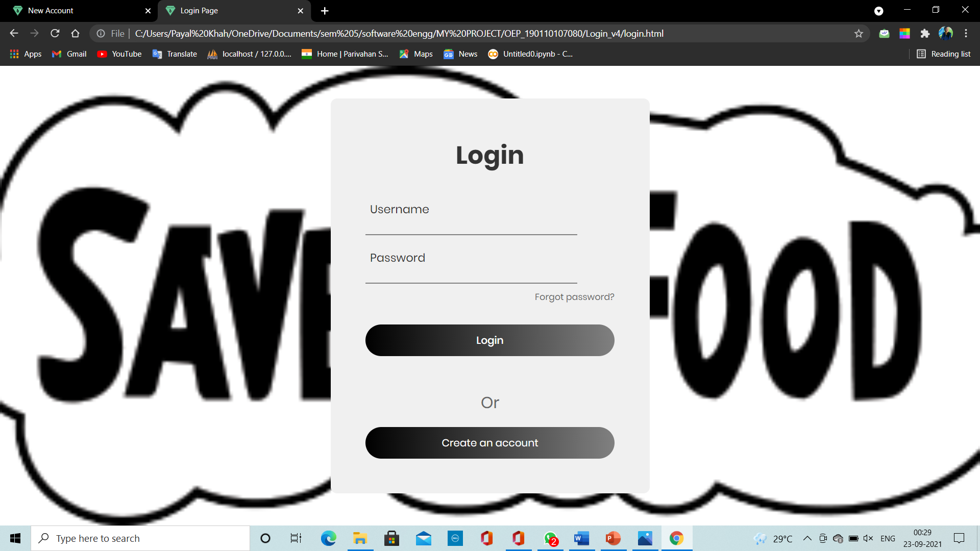
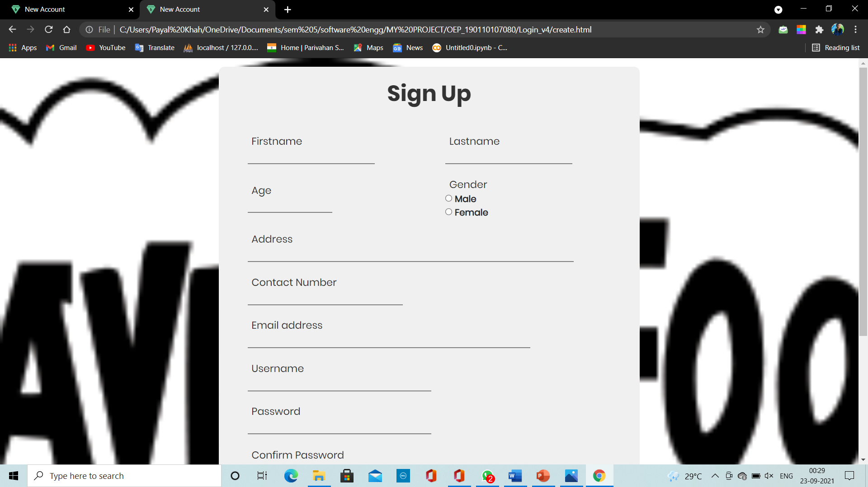

Slide 24
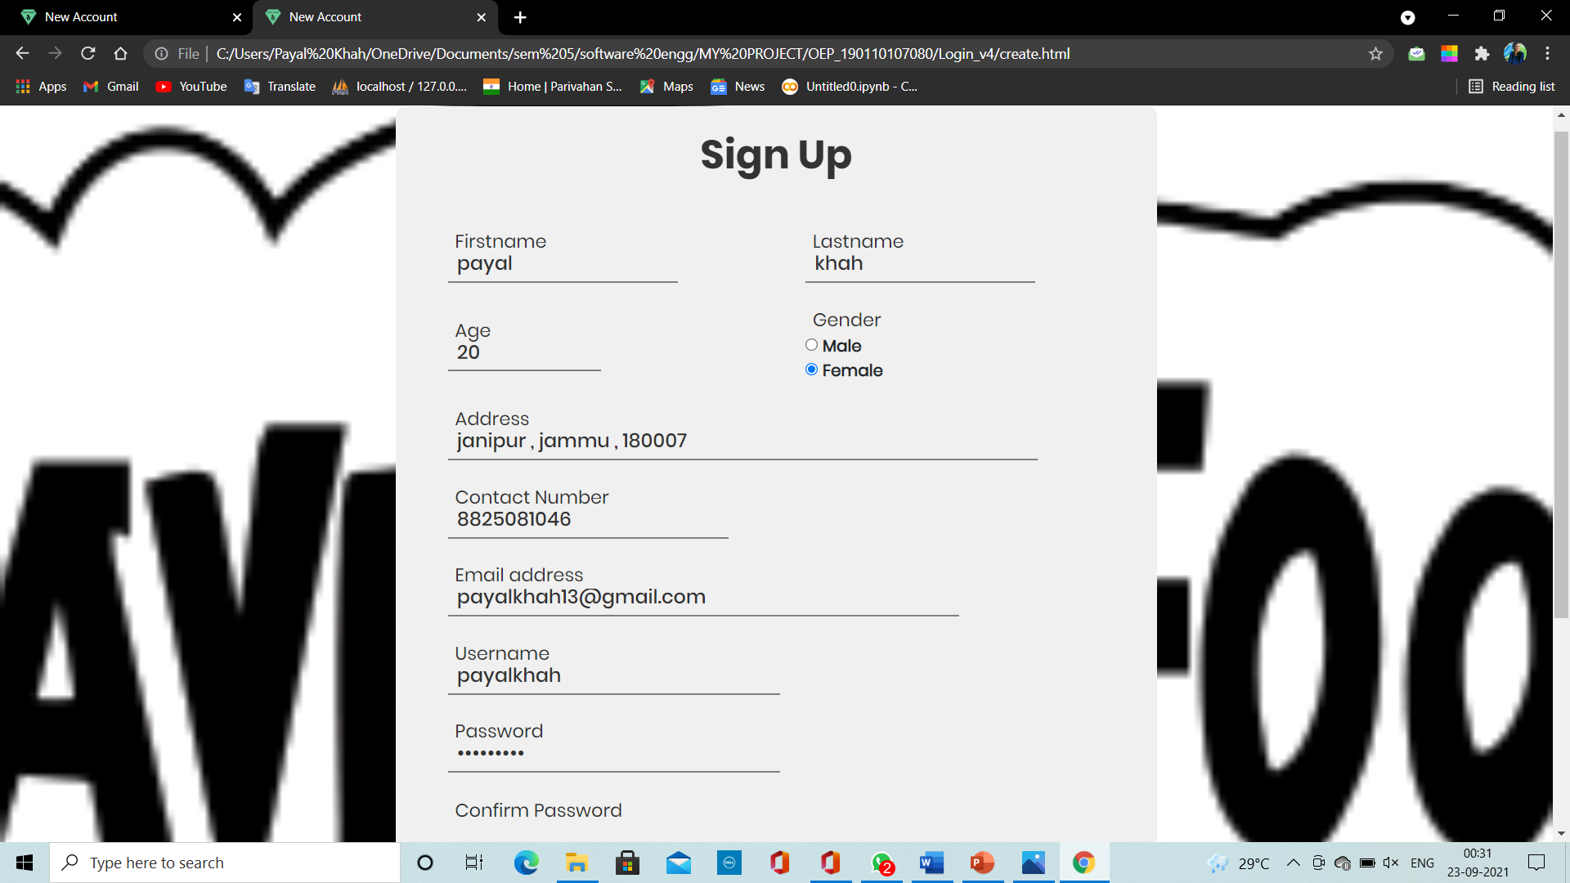

Slide 25
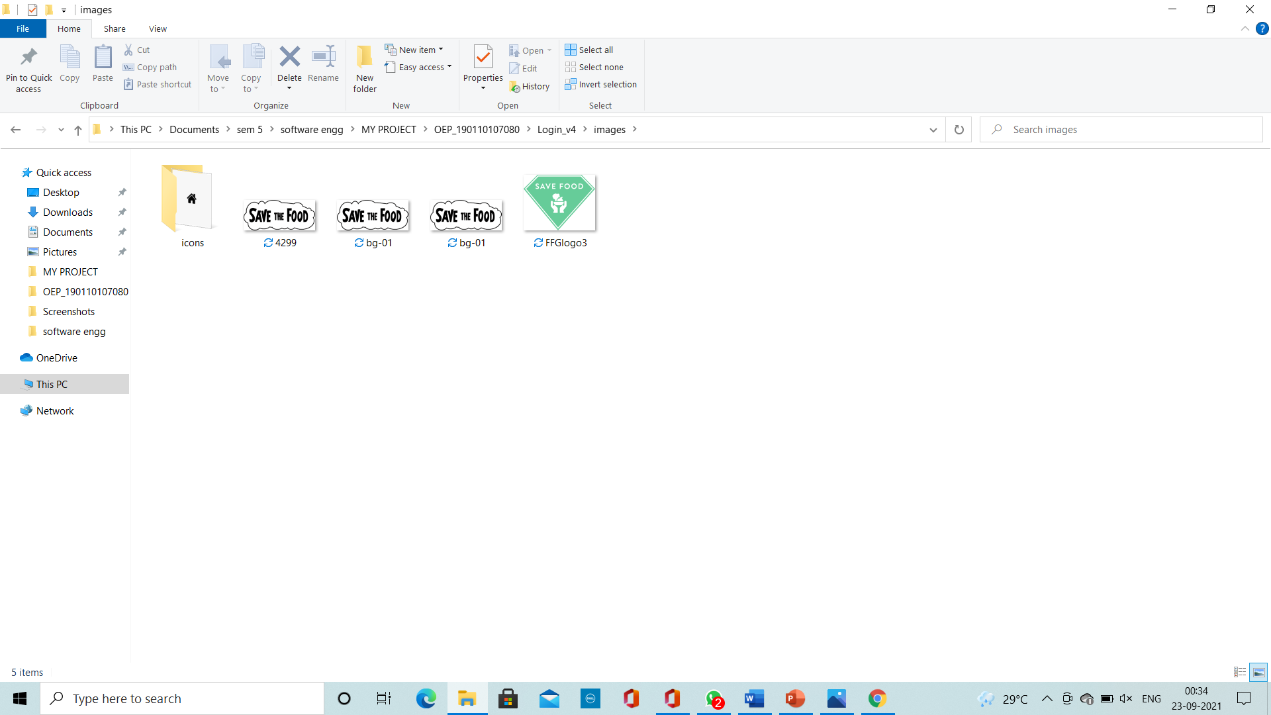

Slide 26
THANK YOU

